Slide 1

Fintech
Campaign
Analysis
Notes:
1

Slide 2
Campaign Overview
Today’s Agenda
Key Observations
Regional Performance
For Campaign Analysis
Distribution Analysis
Spend Analysis
Recommendations

Slide 3

Campaign Overview
In this PPT, we evaluate the performance of a digital advertising campaign run for one of our fintech clients.
The campaign was aimed at driving brand awareness and engagement for a fintech product, with ads delivered across multiple Indian cities, devices (Android, iOS, CTV&Desktop), and formats such as NoSkip and Skip ads.
We segmented the target audience based on demographics like age, gender, and income group to ensure precise targeting.
Our goal is to analyze the campaign delivery data, extract key insights, identify trends, and provide actionable recommendations to optimize future marketing efforts.

Slide 4
Key Observations
12.9 Cr
1.75 Cr
8.7 L
6.3 K
Total No. of
Impressions
Total No. of
Views
Total No. of
Clicks
Total No. of
Installs
2.2 K
0.67 %
0.72 %
35.7 %
Total No. of
Registrations
CTR
(Click-Through Rate)
Install Rate
Registration Rate

Slide 5
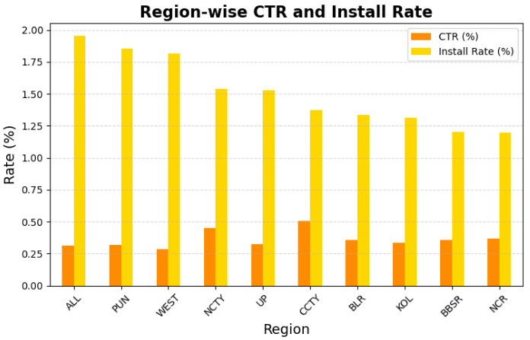
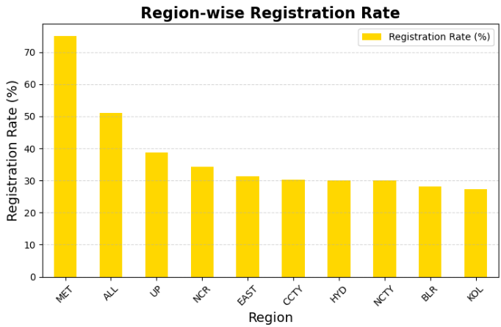
Regional Performance
Despite high CTR, regions like CCTY (1.37) and NCTY (1.53) show moderate install rates, suggesting friction in the install process.
Regions like UP (38.7%), CCTY (30.3%), and NCTY (29.9%) show a major drop from install to registration, pointing to possible issues with UX or app relevance.
MET sets a benchmark for registration funnel efficiency.

Slide 6
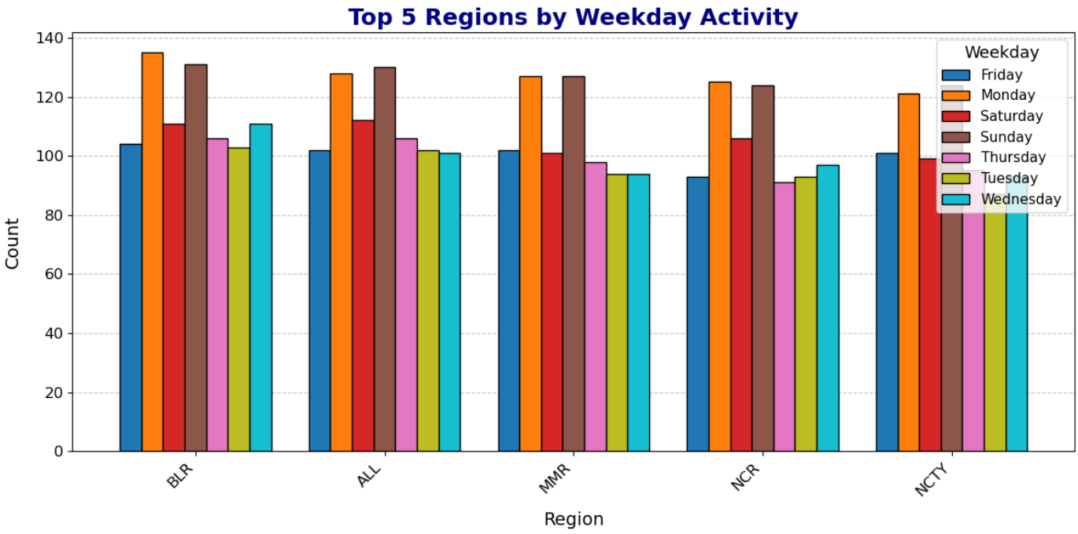
Week wise Performance
Monday & Sunday Are Peak Activity Days Across Regions
Week start and end see highest user engagement, suggesting optimal days for campaign boosts or offers.
Tuesday to Thursday are consistently low
Consider avoiding major launches midweek, or reallocating budget toward high-performing days.

Slide 7
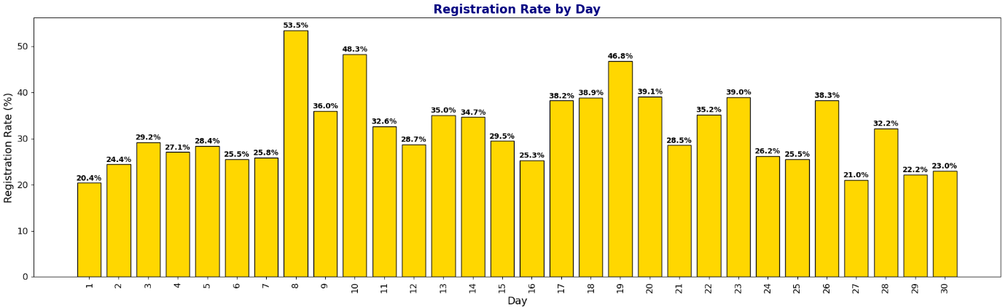
Daily Performance
There might have been a campaign, promotion, or content push around Day 8 that significantly boosted registrations.
Indicates a successful mid-month strategy, suggesting user interest or marketing effectiveness was high during this phase.
Start and end of month may require improved targeting, as user engagement is noticeably weaker.

Slide 8
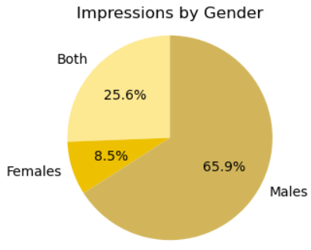
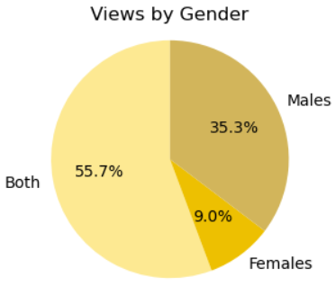
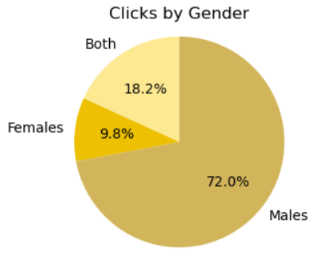
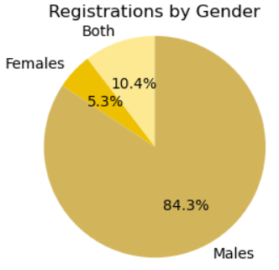
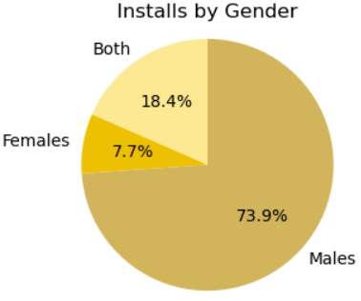
Gender Wise Distribution
Male users dominate in all metrics. Future campaigns should focus on enhancing male engagement and explore ways to boost female participation.

Slide 9
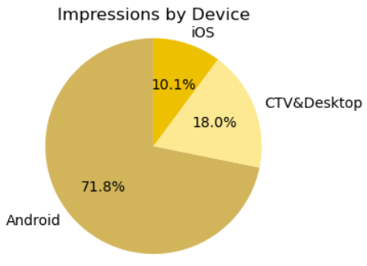
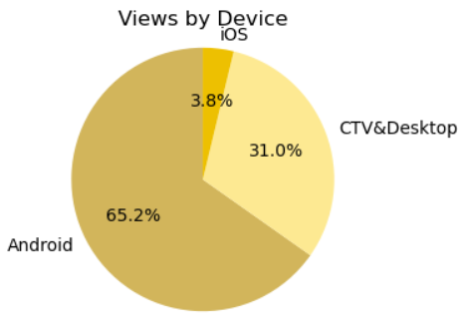
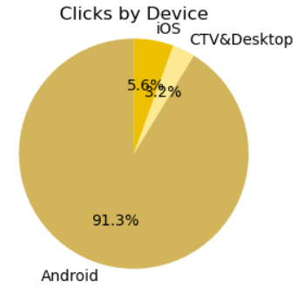
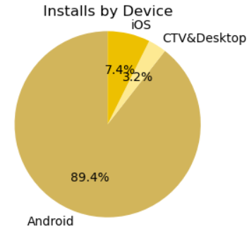
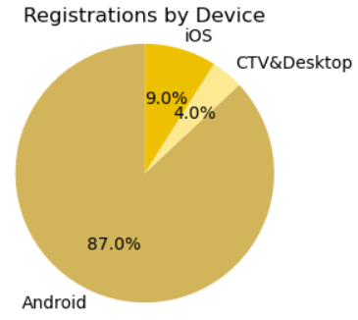
Device Wise Distribution
Android leads in all metrics, outperforming CTV & Desktop and iOS. Future efforts should focus on Android, while exploring improvements for the other platforms.

Slide 10
Spend Analysis
₹ 3.04 Cr
₹ 35
₹ 4.8 K
₹ 13.5 K
CPC
(Cost per Click)
CPI
(Cost per Install)
CPR
(Cost per Registration)
Total Spend

Slide 11
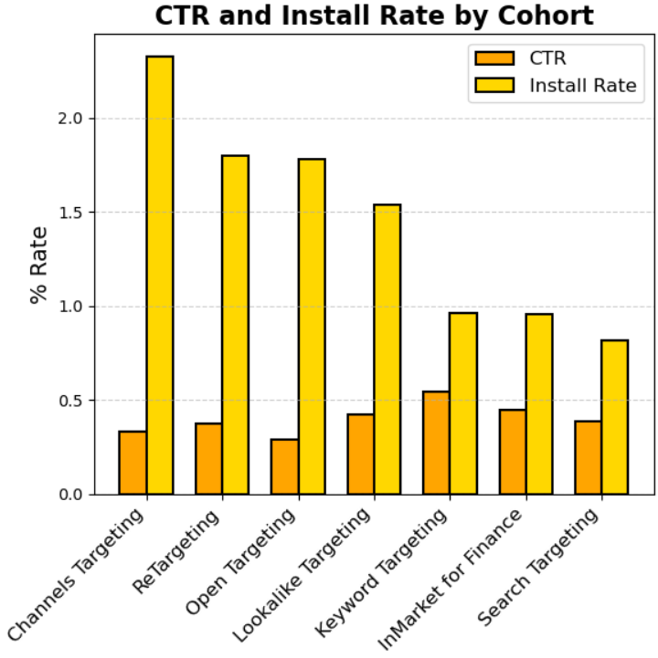
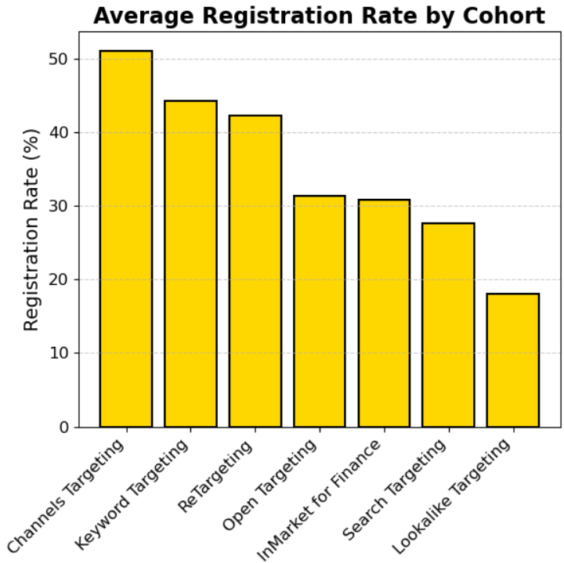
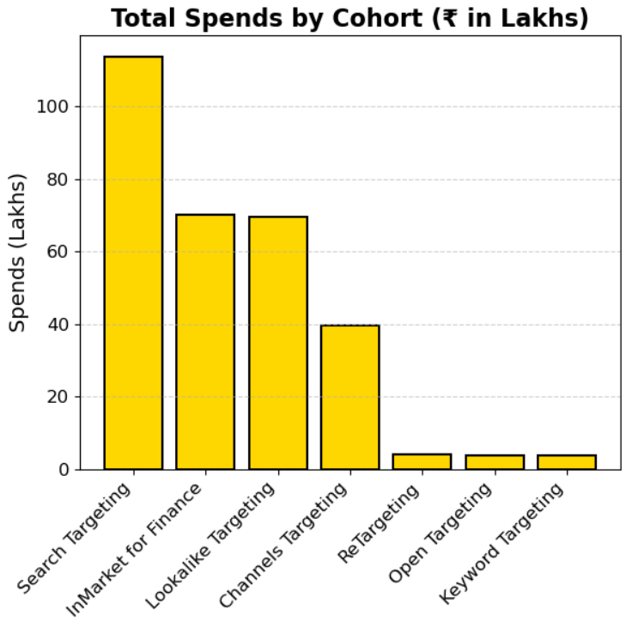
Spend Analysis On Cohort
Search Targeting has the highest spend (₹113.9L) but the lowest install (0.82%) and low registration rate (27.6%) — making it the least ROI-efficient.
Channels Targeting delivers the best overall performance: high registration (51.1%), install (2.33%), and CTR (0.33%) on moderate spend (₹39.66L).
Keyword Targeting has the highest CTR (0.54%), but low installs (0.96%), indicating poor post-click conversion.
Re-Targeting is highly efficient, achieving strong installs (1.79%) and CTR (0.37%) on just ₹3.99L spend.
Lookalike Targeting has high spends (₹69.6L) but poor results: low installs (1.53%) and lowest registration (18%) — showing poor audience match.

Slide 12
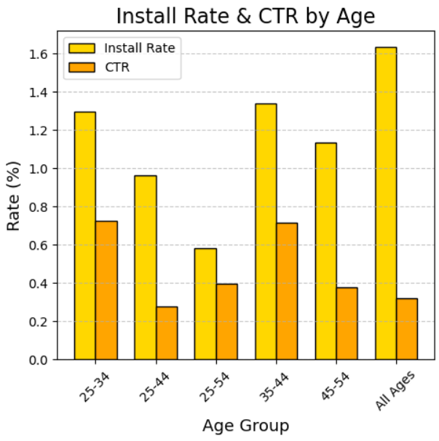
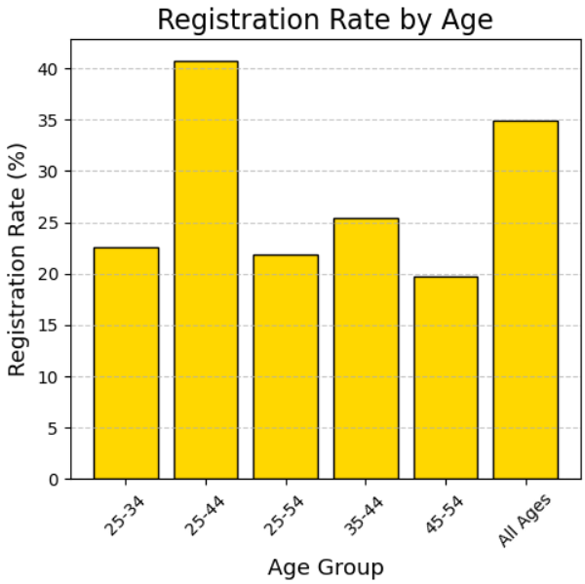
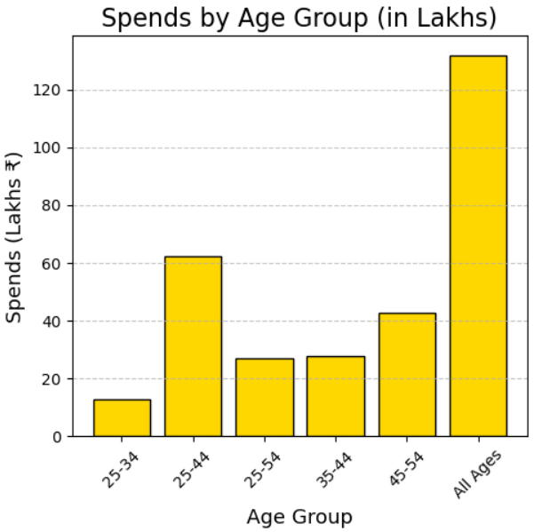
Age Wise Spends Analysis
Age 35–44 offers the best ROI with the highest install rate (1.34%) and high CTR (0.71%) at moderate spend (₹27.76L).
Age 25–44 is least efficient, with highest spend (₹62.4L) but low install rate (0.96%) and very low CTR (0.28%).
Age 25–34 shows great engagement with the highest CTR (0.72%) but converts poorly with low registration rate (22.6%).
Age 45–54 is not cost-effective, having low registration rate (19.7%) despite high spend (₹42.9L).

Slide 13
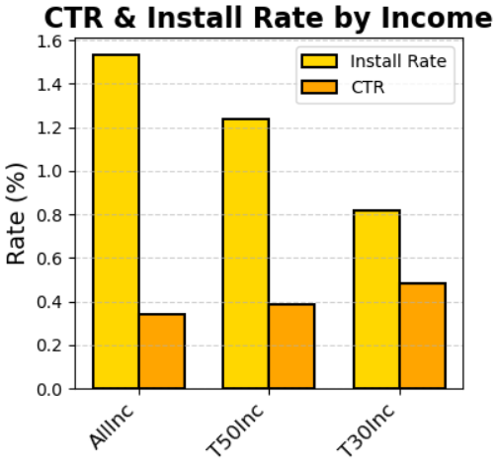
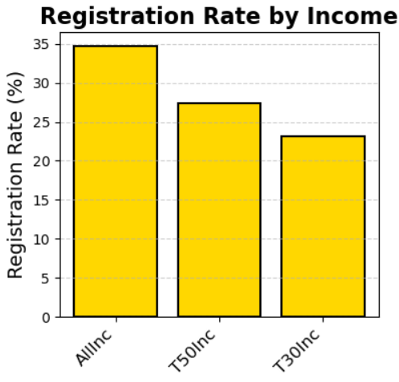
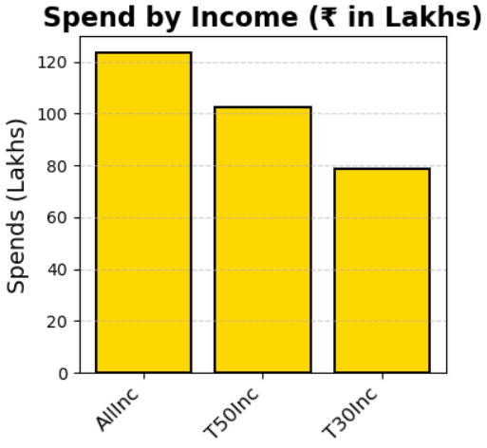
Income Wise Spends Analysis
T30Inc has the highest CTR (0.48), showing strong ad engagement from lower-income users.
T30Inc has the lowest install rate (0.81), indicating a drop-off after the click.
AllInc shows the highest registration (34.72) and install rate (1.53), making it the best-performing segment.
Spends are highest on AllInc (₹123.59 Lakhs), which aligns with its strong overall performance.

Slide 14
Refine Regional Targeting
Focus on scaling ads in regions like NCTY and CCTY, where CTR and Install Rates are higher.
Leverage Age Group Insights
RECOMMENDATIONS FOR FUTURE
Intensify ad spend on 25-44 age groups, as this segment has shown strong CTR and Install Rates. For the 45-54 group, test different messaging or offer more customized incentives to boost conversions.
Reallocate Cohort budget
Shift budget from Search and Lookalike to Channels Targeting and Re-Targeting — they deliver the best ROI with higher installs and registrations at lower cost.
Improve Registration Conversion
Add incentives such as bonus points, discounts, or a simplified sign-up process to increase the Registration Rate across all demographics, especially in low-performing regions and for T30Inc income groups.

Slide 15
Thank You

